Slide 1
Introduction to American Political Institutions
Session 8
American Public Policy

Slide 2
Elections
Duverger’s Law & First-past-the-post elections
Median voter theorem
  2 win-seeking candidates, left-right policy, voters favor closer candidate
  “Swing voter” (median)
Why the median voter theorem breaks down
  Policy-seeking candidates, some uncertainty about location of median voter (Calvert/Wittman model)

Slide 3
Outline
The growth & scope of American government
The reasons why
The ratchet
What the federal government does
What state & local governments do
The Hidden State

Slide 4
A Mini-Quiz
The size of annual federal expenditures is about --
  $300 Billion; B) $1 Trillion; C) $4 Trillion; D) $6 Trillion; E)$30 Trillion
The average federal, state, and local expenditure per capita in the U.S. is about –
  A) 1000 B) 24,000 C) 50,000
The largest single program in the federal budget is:
  A) Defense; B) Social Security (pensions for elderly); C) Medicare (health insurance for elderly); D) Welfare (means-tested programs); E) Foreign Aid
3. The largest tax loophole (“tax expenditure”) subsidizes:
  Private Health insurance; B) Private Housing; C) Charitable contributions; D) Political contributions
4. The largest single category in most state budgets is …
  A) Education; B) Prisons; C) Pensions for state workers; D) Welfare; E) Disaster relief

Slide 5
Three Questions:
Why did government grow?
What does government in the United States do?
    Especially the federal government, but also state and local governments
What is distinctive about the American way of government?
  What is the American Way of Government?

Slide 6
1 The Growth & Scope of Government

Slide 7
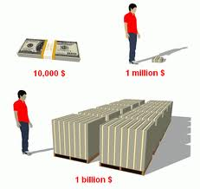
Visualizing the Size of the Federal Budget
$100 bills

Slide 8
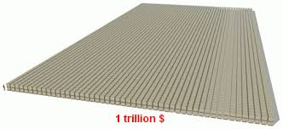
$1,000,000,000,000
FOUR of these!

Slide 9
How did we get here?

Slide 11
As late as 1927, federal expenditures were only about $300/person (real!)
The federal government did almost nothing
About $14,000 per capita today (current dollars) for all govt expenditures

Slide 12
Huge increase starting with the “New Deal”
Response to the Great Depression of the 1930s

Slide 14
2 - Causes

Slide 16
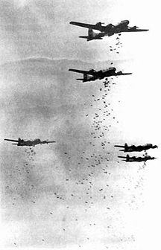
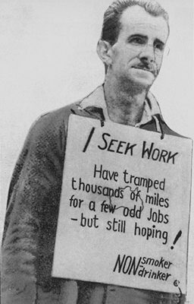
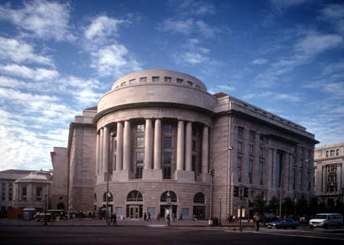
The Growth Equation
=
+

Slide 17
Raises a question …

Slide 18
https://www.youtube.com/watch?v=01-2pNCZiNk

Slide 19


Slide 20
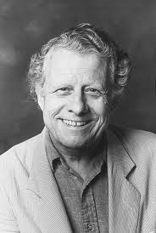
“War makes states, then states make war.”
Charles Tilly

Slide 21
To a considerable extent, WAR built the American government
Making states … that’s what war is good for

Slide 22
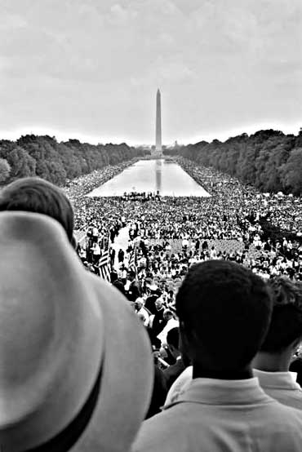
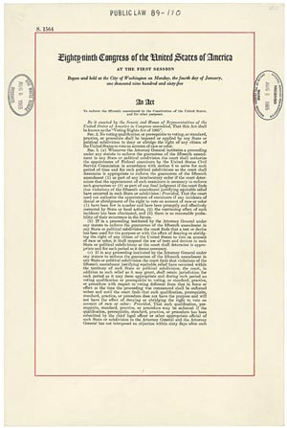
Social Movements & the Rights Revolution
Civil rights Movement
Voting Rights Act & Justice Department enforcement

Slide 23
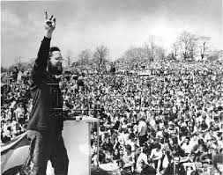
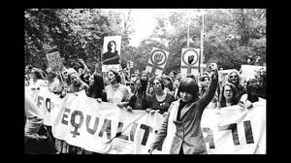
More Social Movements
Earth Day, 1970
Women’s Liberation 1970s

Slide 24
… leading to more legislation and more government regulation

Slide 25
Note the role of war in the expansion of rights
WW I and Women’s Suffrage
WW II and groundwork for Civil Rights Movement
WW II and GI Bill of Rights (education)
Korean War and desegregation of the military
Vietnam and vote to 18-20 year old (26th Amendment)

Slide 26
3 - The Ratchet

Slide 27
Ratchet

Slide 28
After the crisis, expenditures decrease … but never all the way to pre-crisis level

Slide 29
Why not?

Slide 30
“New Policies Create new Politics”
Ideology
Groups

Slide 31
New Policies Alter “Ideology”
Before policies are enacted, their effects are speculative
  Anti-government bias makes people skeptical or hostile
After policies are enacted, speculative effects become concrete
  And life goes on
The status quo becomes the “new normal” and people accept it
Effectively “Ideology” has changed

Slide 32
Groups
New policies create concentrated beneficiaries
  The RECIPIENTS of the benefits
  The PROVIDERS of the services
    Government-by-proxy! Sub-contractors become lobbyists
NEW groups form around the new programs
  More on this shortly
The groups work to maintain the policy
  Exploiting status quo bias

Slide 33
Factoid
Initially most of the Great Society programs, including Medicare, were NOT popular
  Enacted with hot debates about socialized medicine etc
But they BECAME popular over time
  People got used to them
  People discovered they liked the benefits
  Interest groups formed around the programs
Notes:
This is not an iron law. Catastrophic benefit in Medicare. Obamacare took a long time.

Slide 34
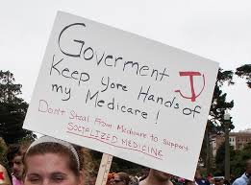


Slide 35
Comparisons with Other Countries

Slide 36
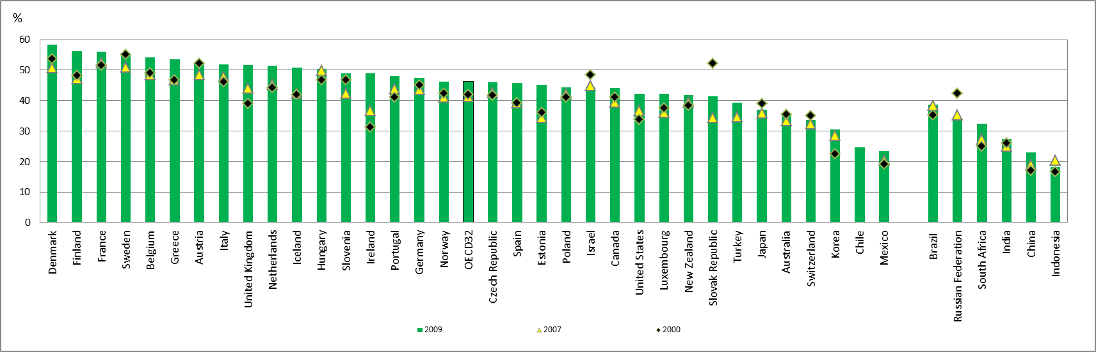
Cross-National Government Spending as a Percent of GDP
OECD data http://www.oecd-ilibrary.org/sites/gov_glance-2011-en/03/04/index.html?itemId=/content/chapter/gov_glance-2011-10-en

Slide 37
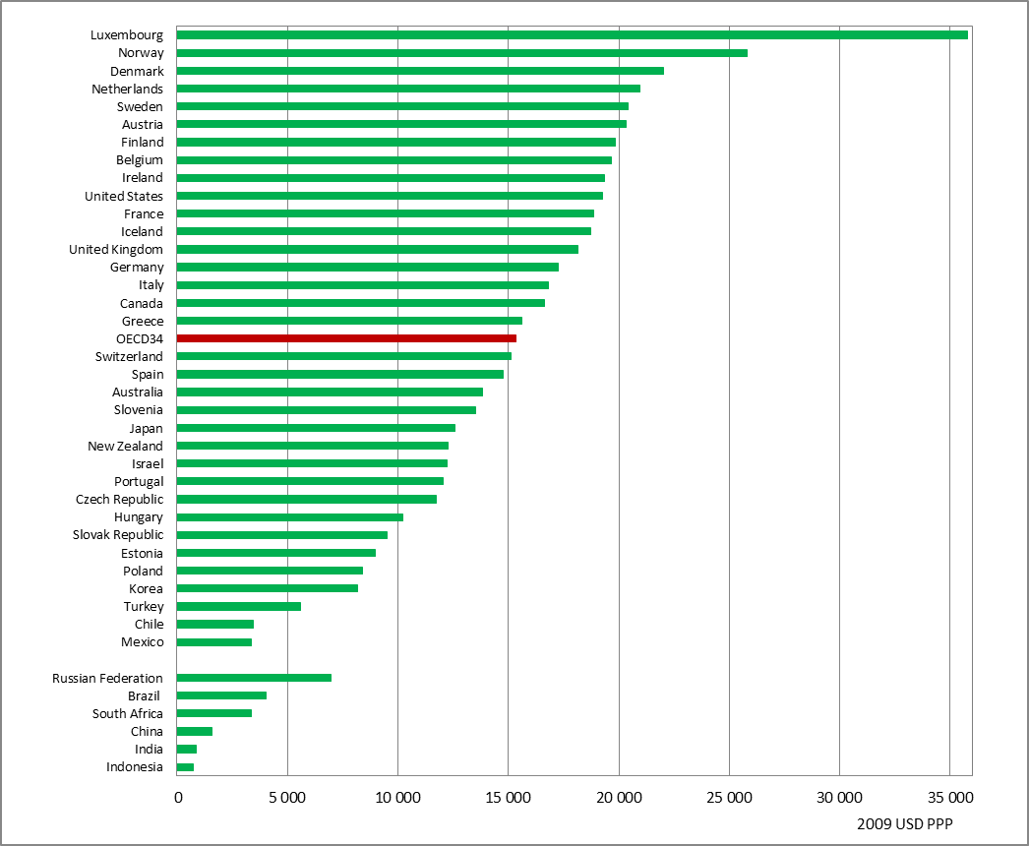
Cross-National Per Capita Government Expenditures

Slide 38
Takeaway Point: The size of United States government is quite similar to that of other advanced industrial nations.
But what the govt does, and how, is unusual

Slide 39
4- What Does the Federal Government Do

Slide 40
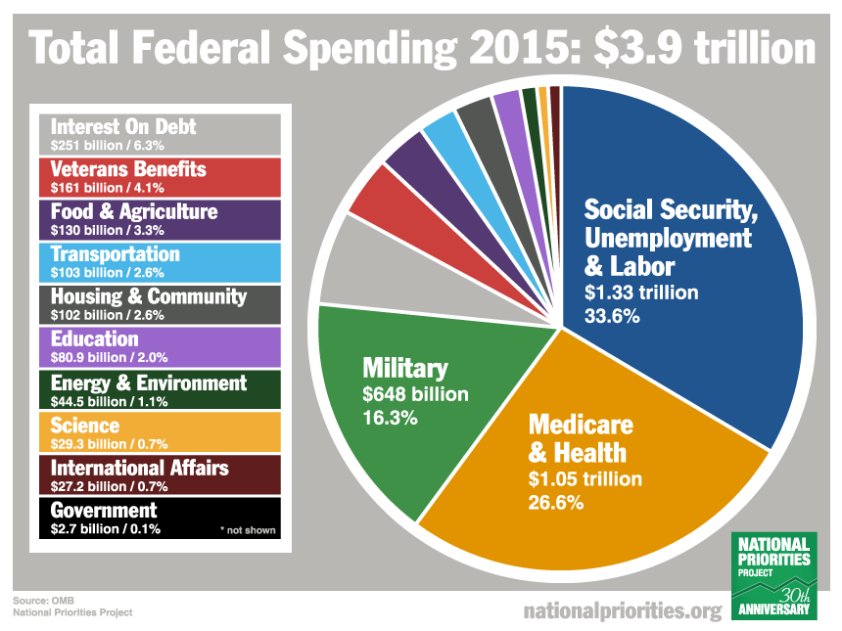
The Federal Budget

Slide 41

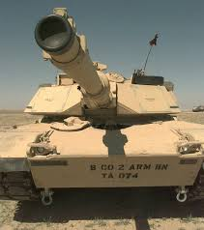
The Federal Government: An Insurance Company with an Army

Slide 42
The Insurance Company: STAR
Most federal laws, in whichever policy domain, authorize Washington to do one of four main things:
Pay Subsidies to particular groups and organizations in society
Transfer money to state and local governments
Award grants or contracts to for-profit firms and nonprofit organizations
Devise and enforce Regulations on the society and economy.
-- John DiIulio, Bring Back the Bureaucrats p. 41.

Slide 43
Federal Spending by Category

Slide 44
Federal Spending by Category

Slide 45
Insurance + Army vs. Everything Else
Federal Spending by Category
Notes:
Two-third vs. one-third

Slide 46
Major Federal Insurance Programs: Social Security
The centerpiece of the social welfare state

Slide 47
Social Security: Basics
Taxes today’s workers in order to pay monthly checks to today’s retirees
  There is no “account” you are “paying into”
  Your payroll deductions go directly to old people
  You pay for Granny
Tax is taken from paychecks
In 2008, about $615 B was paid to about 51M recipients
  About $12000 per year, or about $1000 per month
  Now about $1200/month, with 56M beneficiaries

Slide 48
Social Security: Impact on Elderly
Most Americans have negligible savings, especially for retirement
  Federal Reserve surveys find that about 30% of Americans have NO retirement savings at all
  http://www.federalreserve.gov/econresdata/2013-report-economic-well-being-us-households-201407.pdf
For many Americans, Social Security is their ONLY or main source of post-retirement income
But few elderly are poor, mostly because of Social Security (and Medicare and Medicaid)

Slide 49
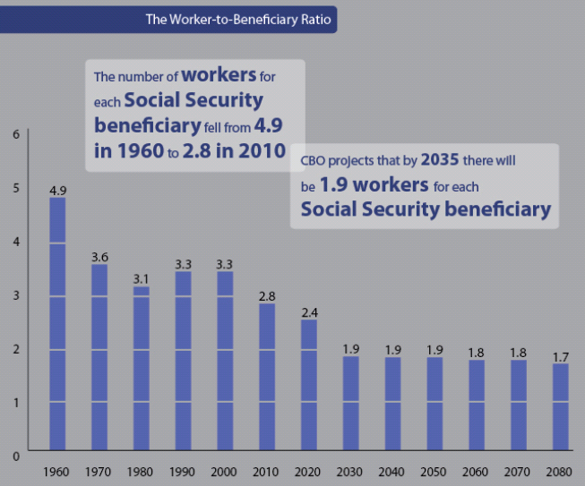
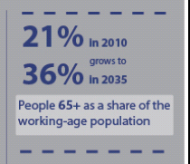
Social Security: Tax Burden

Slide 50
Achieving long term stability is relatively easy
But politically painful

Slide 51

Best Current Analysis

Slide 52
Major Federal Insurance Programs: Medicare

Slide 53
Health Insurance for Elderly
Hospital Care
Doctors
Drugs
NOT long term care

Slide 54
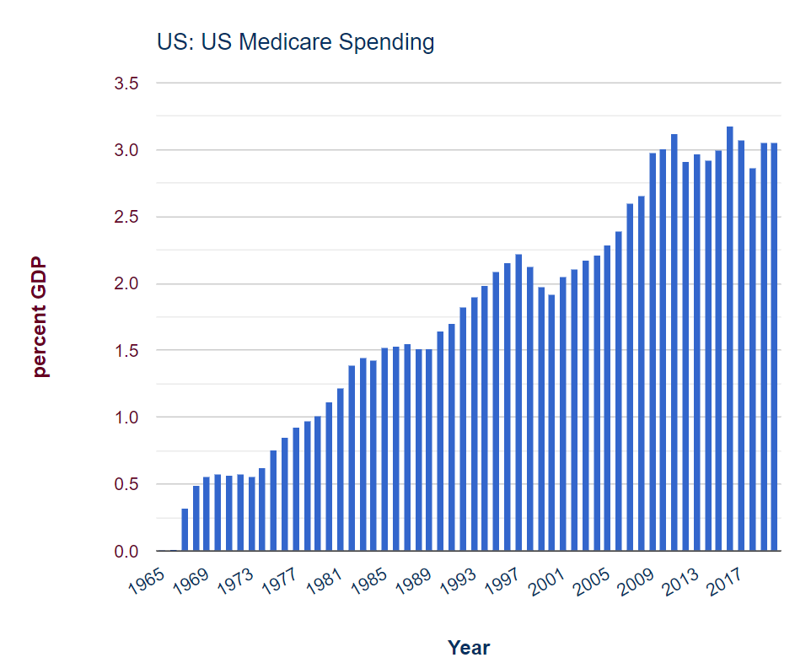

Slide 55
SERIOUS PROBLEM!
Medicare:
Notes:
What to do with this slide?

Slide 56
Partly aging … but mostly it’s the prices
Why?
Reinhardt AER
Notes:
What to do with this slide?

Slide 57
Takeaway Point: Medicare’s horrible problems are less about budgetary issues per se than about the health care system in America
Which is FUBAR: fowled up beyond all recognition

Slide 58
Major Federal Insurance Programs: Medicaid
A federal-state health care program for (basically) poor people

Slide 59
Medicaid: The Basics
Originally, health insurance for welfare recipients
Represents the biggest single line item in most state budgets
Eligibility has expanded beyond welfare recipients in many blue states
Often used to cover the costs of nursing home care
Was expanded under the Affordable Care Act in 2010
Notes:
ACA expansion turned out to be its most important provision

Slide 60
Federal Military Spending

Slide 61
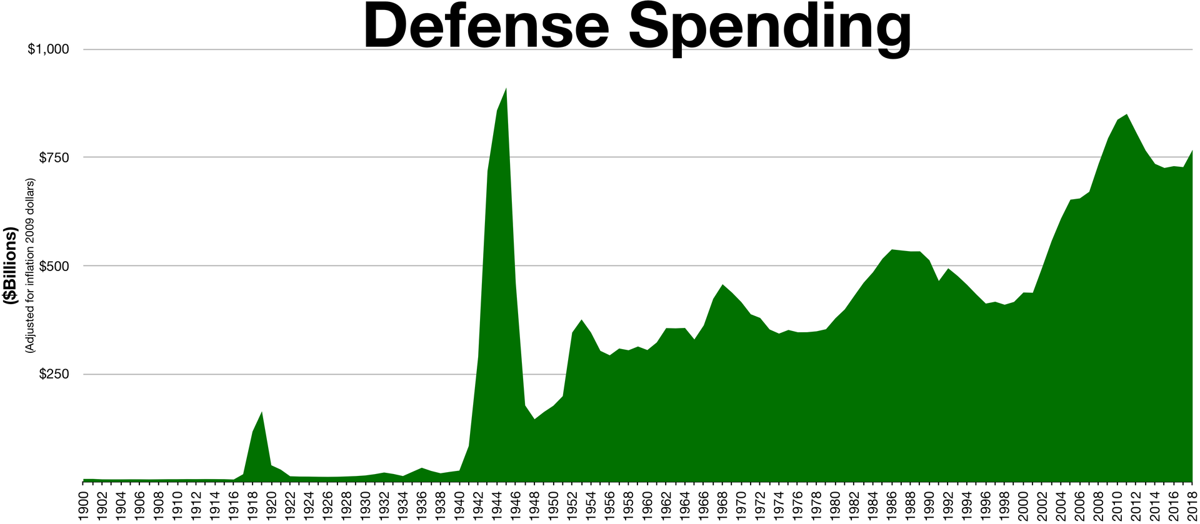

Slide 62
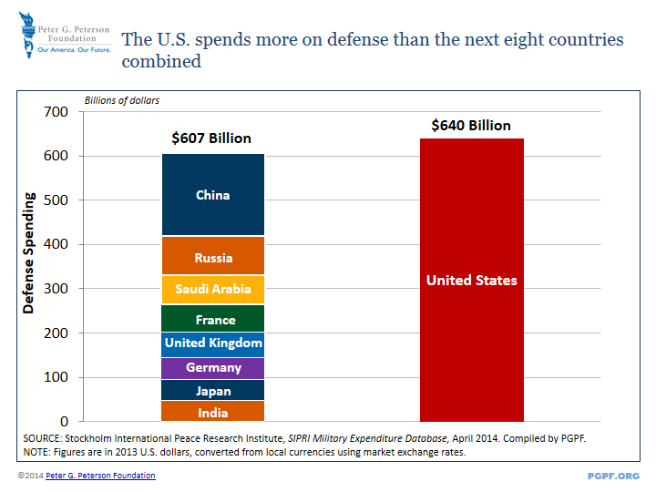
Military Spending: America vs. Other Countries

Slide 63
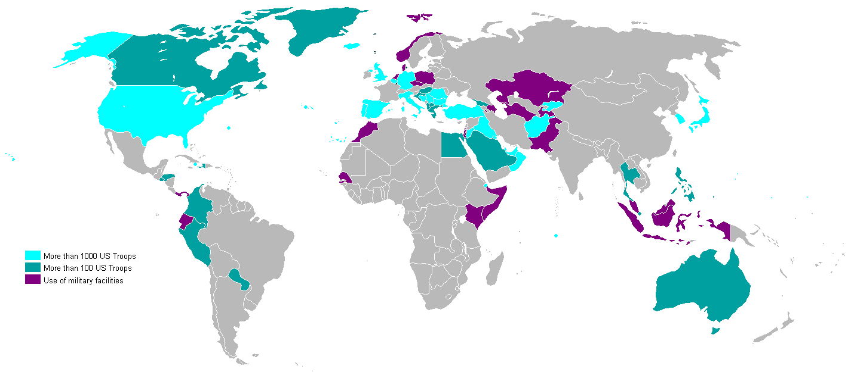
Military Spending: American Troops and Facilities

Slide 64
Takeaway Point: The United States acts as a global hegemon
Able to project mind-boggling force anywhere, anytime
This is very very very expensive to do

Slide 65
Other Federal Discretionary Spending
Think: Research, weather bureau, federal police, courts, farm subsidies, student loans, housing, highways

Slide 66
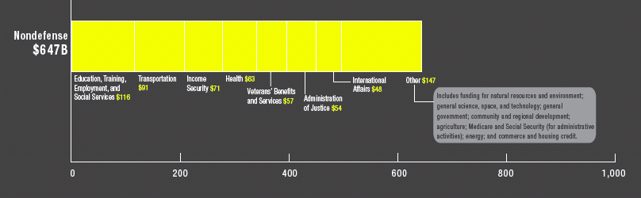
Discretionary Spending: By Type

Slide 67
Paying for Federal Government Spending

Slide 68
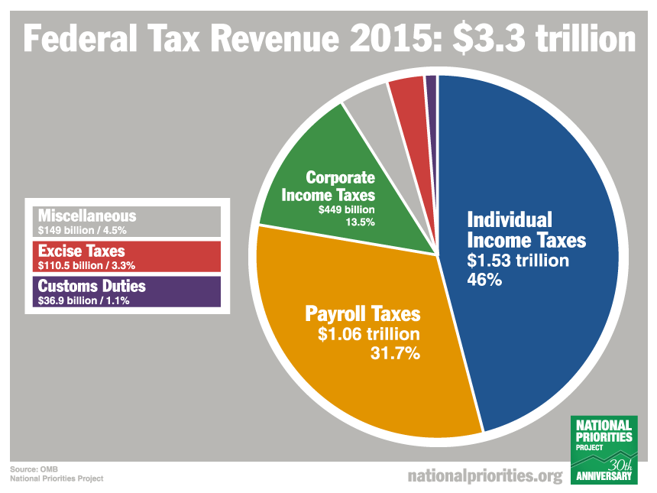
Federal Revenues: By Source

Slide 69
No VAT, no federal sales tax

Slide 70
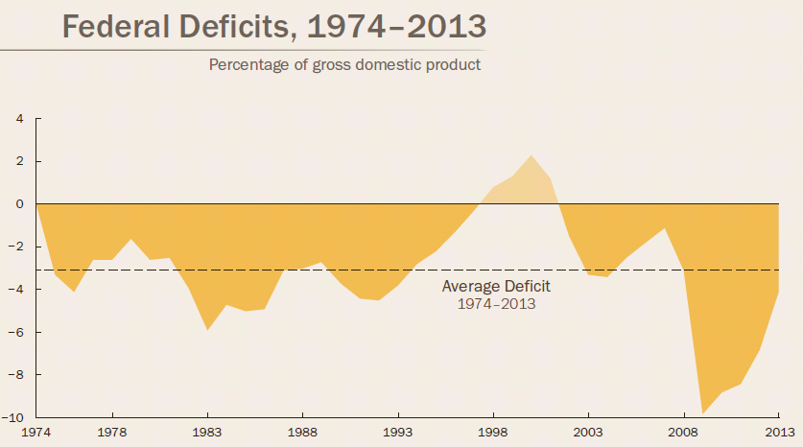
Federal Revenues: Deficits

Slide 71
State and Local Governments

Slide 72
How Much Money?
About $3 trillion!
Varies hugely across the states

Slide 73
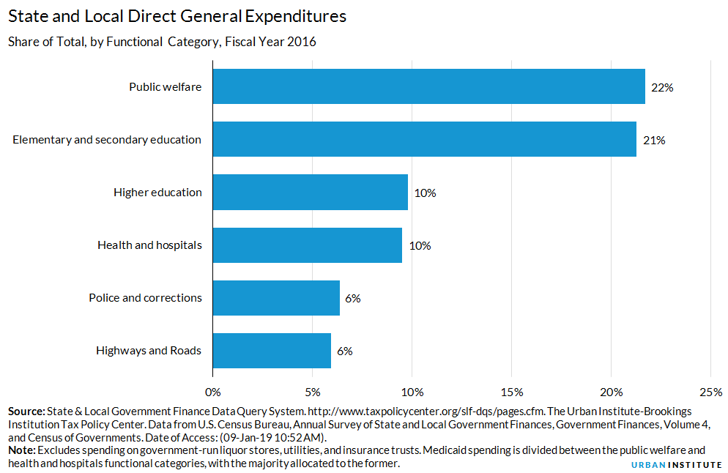
Where the State Dollars Go
Notes:
Public welfare means, mostly, Medicaid

Slide 74
Think --
MEDICAID (#1)
Schools
Prisons
Roads

Slide 75
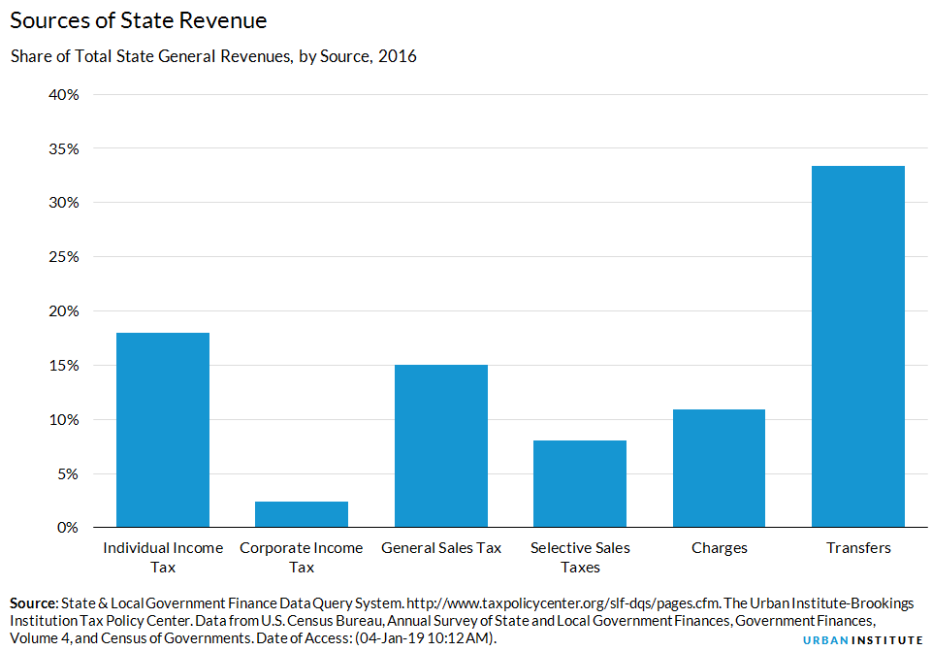
Where Their Dollars Come From

Slide 76
Think --
FEDERAL GOVT
Income taxes
Sales taxes

Slide 77
6 -The Hidden State

Slide 78
The Hidden State: Definition
The benefits that the American people receive from government are often hidden or obscured.
So, many people aren’t aware of the benefits they receive from the federal government
Two devices: Tax loopholes and Government by Proxy

Slide 79
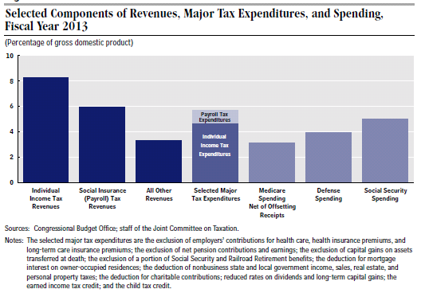
Loopholes: Bigger than Social Security!

Slide 80
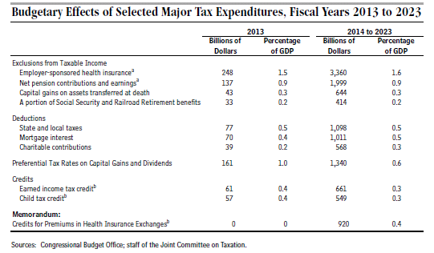
Major Tax Expenditures

Slide 81
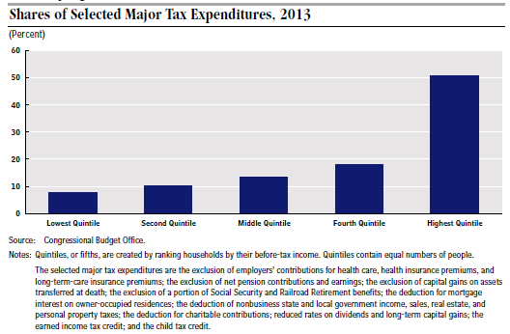
Who Gets the Benefits of Loopholes

Slide 82
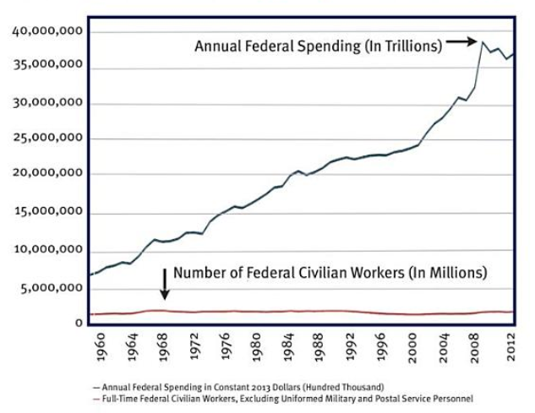
Magic! Growth of Govt Without Growth of Government Employees

Slide 83
Government by Proxy
Using contractors -- non-profit organizations and for-profit firms -- and state and local government to supply services
RATHER than federal employees and federal agencies
Effectively HIDES the hand of the federal government
Also makes managing government almost impossible

Slide 84
Why a Hidden State?

Slide 85
Americans are ambivalent about “government”
Uniquely American: Public Distrust
They distrust “government” and want it to remain smaller
(or so they say)

Slide 86
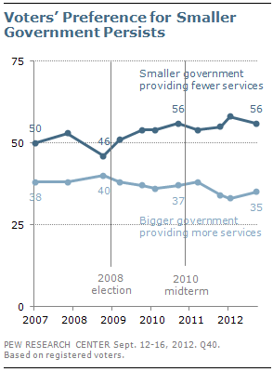
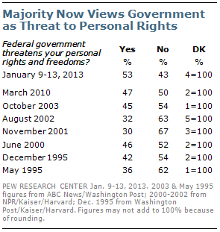
Uniquely American: Small Government as the Ideal

Slide 87
But they actually LOVE government services and don’t want to cut them
Uniquely American: Contradictory Preferences

Slide 88
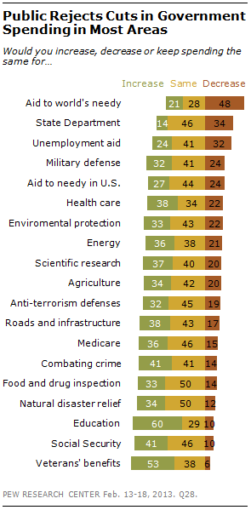
Uniquely American: Don’t Cut That!
Notes:
Start at bottom and read up

Slide 89
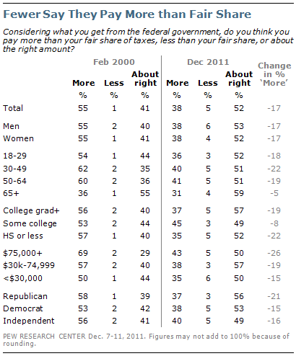
Uniquely American: I Pay Enough in Taxes!
But, they say the tax system is too complex and unfair, esp. because rich people don’t pay enough taxes

Slide 90

Tax Reform
“Don’t Tax You – Don’t Tax Me – Tax That Man Behind the Tree!”

Slide 91
Congress & Presidents have given people what they want
Lots of services with the illusion of small government, financed with hidden taxes and deficits

