Slide 1
Introduction to American Political Institutions
Session 4
Bureaucracy

Slide 2
Outline
A Personnel Experiment at Apple
Four Key Federal Personnel Policies
Consequences of the Big Four Policies
Solutions

Slide 3
A New Day at Apple?
Thought Experiment

Slide 4

Apple Inc.
Producer of consumer electronics … famous for integrating design, engineering, manufacturing, marketing, and retailing at a very high level

Slide 5
Personnel Policies
72,000 employees
Employees specialize tightly in order to have extremely high expertise in functional areas
Projects have a “directly responsible individual” with high accountability
Compensation often uses stock options
Apple “fellows” reward contributions, paid sabbaticals for top engineers

Slide 6
Imagine Tim Cook tries an experiment in personnel policies ….
All top decision makers are fired and re-hired from people outside Apple on the basis of personal loyalty to Cook
Henceforth no Apple employee is allowed to rise into a top decision-making job – only Cook appointed outsiders
Cook expands the central office and runs many projects from his headquarters, over-ruling or ignoring Apple engineers and designers
Otherwise, many design, engineering, manufacturing, and marketing projects are sub-contracted to companies outside Apple
Sub-contractors are encouraged to make cash payments to Apple Board members who are allowed to intervene below
At random intervals Cook imposes hiring freezes, furloughs, and pay cuts

Slide 7
What would these policies do to Apple’s culture and competence?
Think about it …

Slide 8

The New iPhone
It weighs 40 pounds, costs $40K, doesn’t work, and can’t be repaired

Slide 9
Federal Personnel Policies
The Big Four

Slide 10
The Big 4 Policies
Short-term political appointees hold most of the good jobs
Presidents meddle opportunistically from the Center
Much work is subcontracted, esp. to a select group of big private contractors
Congress imposes random hiring freezes and pay cuts
  And, during divided party govt, deliberately sabotages “enemy” programs

Slide 11
1. Massive Politicization
Most policy making jobs are held by short-term political appointees

Slide 12
We think of the US govt as run by a professional civil service like other advanced industrial countries
This is false

Slide 13
Rather, a dual personnel system
In general –
1) Lower level jobs are civil service
2) Higher policy and managerial jobs are short-term political appointees

Slide 14
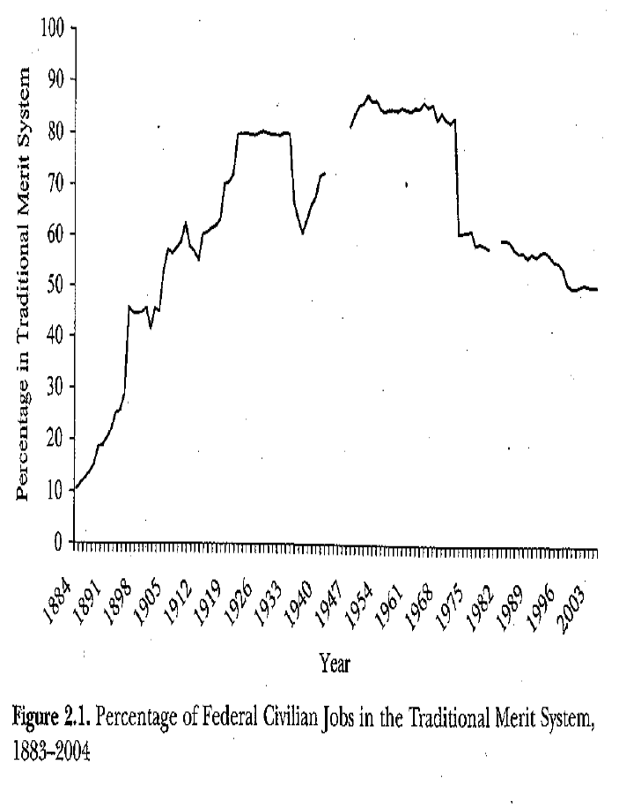

Slide 15
Traditional GS now down to 50%, about the same at 1905
Slight exaggeration, as some agencies have their own similar system

Slide 16
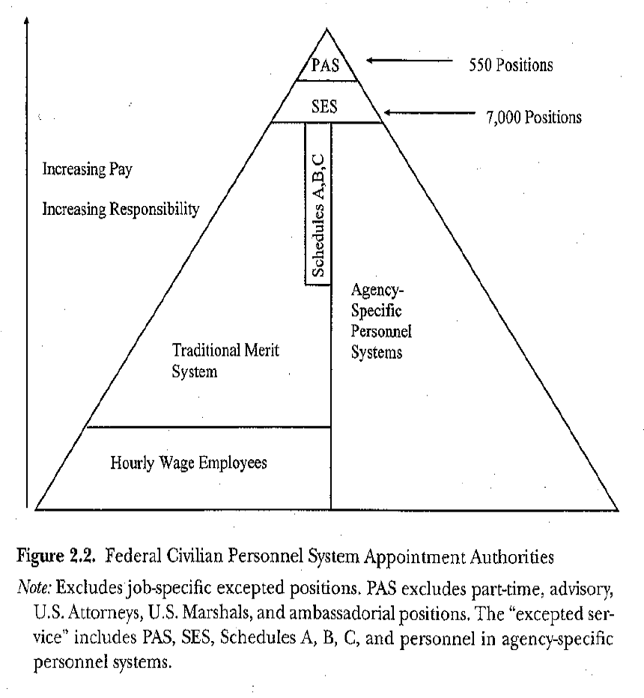

Slide 17
Definitions
PAS – Presidential Nomination and Senate Confirmation
  Top jobs (600)
SES – Senior Executive Service (7000)
  Civil servants with higher pay but can be treated more flexibly than regular civil servants
  Some political appointees designated non-career SES
Schedule C – Positions of a confidential or policy-determining nature, but not PAS (app 1600)
Many agencies are removed from OPM/civil service, have their own
  Defense

Slide 18
Politicization in practice
“Politicization is at the top levels and involves an increase in the number of PAS, SES, and Schedule C, and similarly agency-specific, appointees.”

Slide 19
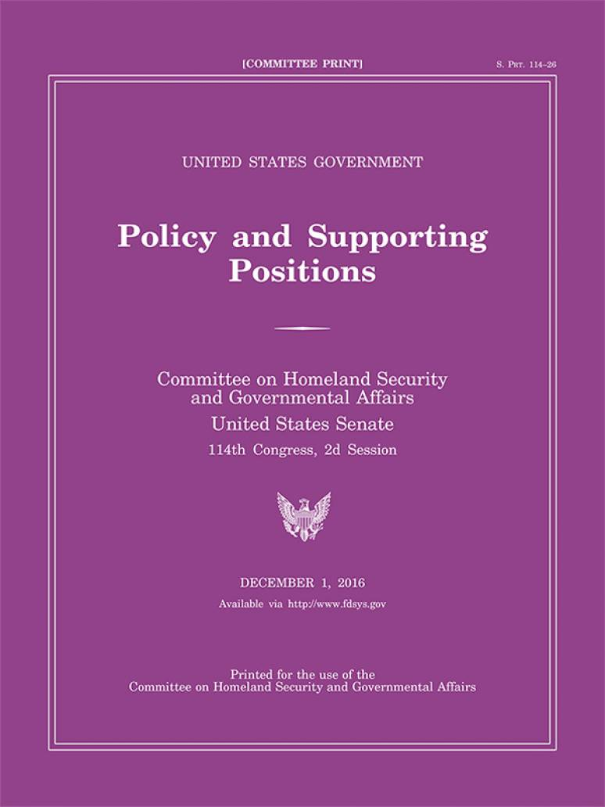
The Plum Book
The Plum Book lists over 7,000 Federal civil service leadership and support positions in the legislative and executive branches of the Federal Government that may be subject to noncompetitive appointment, nationwide. Data covers positions such as agency heads and their immediate subordinates, policy executives and advisors, and aides who report to these officials.

Slide 20
Case Study: The Department of Health and Human Affairs
About: http://www.hhs.gov/about/
Leadership: http://www.hhs.gov/about/leadership/leaders.html
  All are political appointees (and short-term)
CMS org chart (next slide)
  http://www.cms.gov/About-CMS/Agency-Information/CMSLeadership/Downloads/CMS_Organizational_Chart.pdf
  Every head of every box is a short-term political appointee
  Consider the jobs -- Does this make sense?

Slide 21
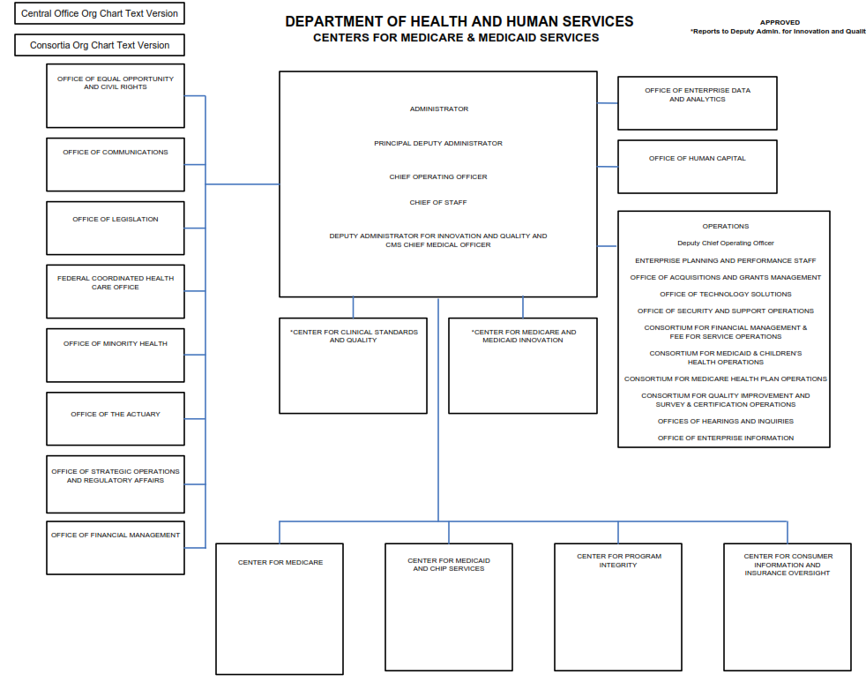

Slide 22
2. Presidential Centralization
Presidents meddle from the center

Slide 23
(We already discussed)

Slide 24
3. Sub-contracting has exploded
While federal employment is flat

Slide 25
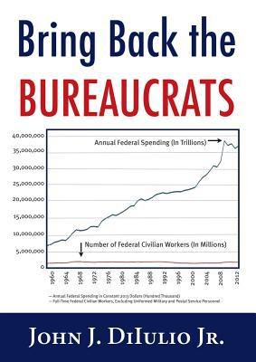

Slide 26
Many federal government functions or operations are now performed by private sector contractors
With nominal oversight from over-worked under-trained contract officers

Slide 27


Case Study: United States Investigations Services

Slide 28
The US govt subcontracts the vetting of individuals for security clearances. A big player is USIS, United States Investigation Services.
  USIS is a former govt agency taken private by a private equity firm.
  USIS cleared Edward Snowden for a security clearance; he subsequently stole 1.5 million top secret documents, leaked them to the press, and absconded to Russia.
Judicial Watch: Many of USIS top executives were SES officials with close connections to the Office of Personnel Management (OPM). http://www.judicialwatch.org/blog/2014/04/sued-for-fraud-by-doj-security-co-that-cleared-snowden-works-for-u-s-immigration/

Slide 29
More…
DOJ has accused USIS of fraud in 665,000 clearances.
  Financial considerations led to shoddy work, but also to big bonuses for management.
“According to the relator’s complaint, starting in 2008, USIS engaged in a practice known at USIS as “dumping.” Specifically, USIS used a proprietary computer software program to automatically release to OPM background investigations that had not gone through the full review process and thus were not complete. USIS allegedly would dump cases to meet revenue targets and maximize its profits. The lawsuit alleges that USIS concealed this practice from OPM and improperly billed OPM for background investigations it knew were not performed in accordance with the contract.”

Slide 30
Formidable regulations and confusing paperwork prevent the entry of small nimble contractors
Effectively only a limited number of very large specialized companies can bid for contracts

Slide 31
These companies are major campaign contributors and employ numerous lobbyists

Slide 32
Implications for the ability of agencies to manage contractors?

Slide 33
4. Shut-downs, hiring freezes, and pay freezes are frequent

Slide 34
“Grade creep”
If you can’t hire from outside, what do you do? Promote lower level employees regardless of talent

Slide 35
How can USG possibly work???
Question asked me by one of your predecessors

Slide 36

Highly recommened: Fun portraits of real bureaucrats, mostly appointees

Slide 37
“Intrinsic Motivation”
When I say, “political appointee” you think “hack”
  Some of them are
  “Turkey Farms”
But as Lewis shows: many are dedicated, idealistic, hard working people who have experience in related jobs in state and local government or in the private sector
Therefore: many of them are pretty decent employees (for the short time they are there)

Slide 38
Policy Successes Are Possible
Almost all of the federal response to COVID was a shambling disaster
But: the public-private partnership “Operation Warp Speed” was one of the great post-war policy success stories

Slide 39
In general: The 4 policies bring many bad consequences

Slide 40
Consequences of the Big
Four Personnel Policies

Slide 41
Consequences
“Lights on, nobody’s home”
“What’s this job again?”
“I give up” (and – “I quit”)
“Its out of control!”
Net Result: On average, a medium capacity government

Slide 42
(1) Lights on, nobody home
Huge numbers of vacancies in policy making jobs at any given point in time – app. 25%!
  Most appointees stay only about 18 months
  They move on after burnishing the resume
  Filling the job, including confirmation during polarized government, takes many months
  Result: Lots & lots of empty policy jobs
At beginning of term, govt is essentially “hollow”

Slide 43
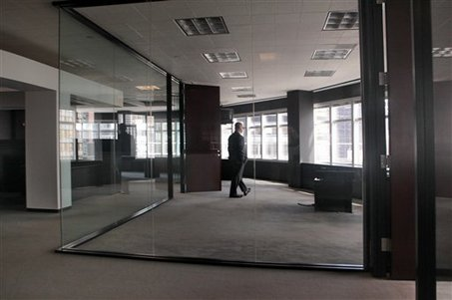
Lights On, Nobody Home

Slide 44
Case Study: Obama Admin attempting to counter the 2008 economic collapse
Almost no one in policy jobs at Treasury

Slide 45
(2) What’s This Job, Again?
Relatively low levels of knowledge and weak personnel networks among those in most policy job holders
  In some cases due to a low level patronage appointment (FEMA: “Heck of job Brownie”)
  More typically due to short tenure: lack of familiarity with details, personnel networks, history, and not there long enough to learn
  Little interest in long-term projects
  Few long-term relationships based on trust (relational contracting impossible)

Slide 46

What is this job again?

Slide 47
(3) I give up (and – I quit)
Blocked career paths for career civil servants
& Little influence over policy

Slide 48

Policy Maker

Slide 49
Predictable result

Slide 50

Working Hard

Slide 51
Micro-foundations
Politicization seriously degrades job satisfaction
Best bureaucrats have outside options – they leave
  Ex: Porter Goss’s effect on CIA
Many politicization tactics try to induce exit or reduce power of skilled bureaucrats
Political replacements often have less skill/knowledge/expertise/personnel networks
Politicization de-motivates remaining professionals
  Less effort
  Less investment in own expertise

Slide 52
Result: Low effort, low investment in human capital and job specific skills by civil servants
Also, thoroughly demoralized
Who remains in these jobs?

Slide 53
(4) Its out of control
Subcontracted government often works very poorly
  Low accountability of contractors
  Extreme difficulty in coordinating them
  Extreme difficulty in firing them for poor performance
Adding new functions to government becomes problematic
IT innovations in particular become very very difficult

Slide 54
Case Study: The Sinkhole of Bureaucracy
http://www.washingtonpost.com/sf/national/2014/03/22/sinkhole-of-bureaucracy
“Here, inside the caverns of an old Pennsylvania limestone mine, there are 600 employees of the Office of Personnel Management. Their task is nothing top-secret. It is to process the retirement papers of the government’s own workers.
But that system has a spectacular flaw. It still must be done entirely by hand, and almost entirely on paper... During the past 30 years, administrations have spent more than $100 million trying to automate the old-fashioned process in the mine and make it run at the speed of computers.
They couldn’t.”

Slide 55
There are many similar examples

Slide 56
FAA Flight Control System
“Flying Blind: The Tech Unfriendly Skies,” Wired March 2015 http://www.wired.com/2015/02/air-traffic-control/

Slide 57
IRS Computers
Horribly bungled upgrade attempt Many GAO reports, Bozeman
They continue to use 1960s technology

Slide 58
VA Hospital Construction (Denver)
    bhttp://www.washingtonpost.com/politics/va-building-projects-riddled-with-mistakes-and-cost-overruns/2015/04/13/e66279b4-d4b9-11e4-a62f-ee745911a4ff_story.html
“The combination of extravagant planning divorced from financial reality and bungled ­execution has bedeviled several recent VA projects, the GAO found.”
http://www.washingtonpost.com/blogs/federal-eye/wp/2015/05/22/money-and-time-is-running-out-for-vas-denver-hospital/?tid=hpModule_308f7142-9199-11e2-bdea-e32ad90da239&hpid=z15

Slide 59
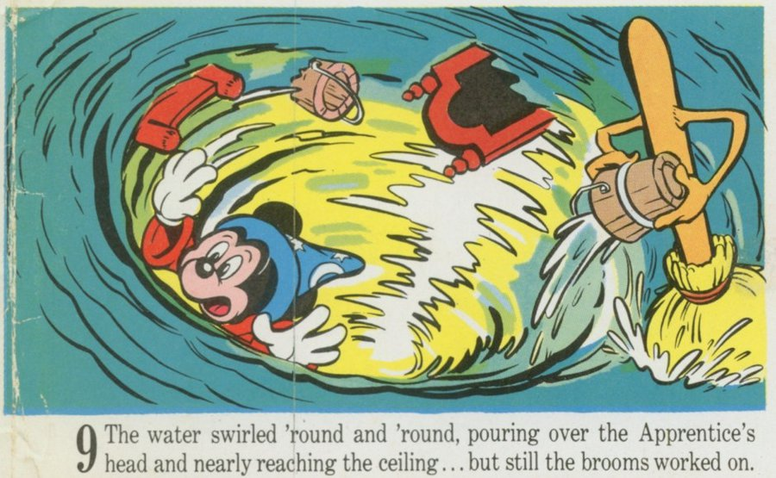
Its Out of Control!

Slide 60


Slide 61
Bottom Line
The Big 4 Personnel Policies have seriously degraded the capacity of the US federal government to govern.
With some exceptions, USG is no longer a high capacity organization.

Slide 62
Some Exceptions
The military
  General officers are NOT political appointees
  Military has big budgets
  They get lots of experience actually fighting, and try to learn
  (Sub contracting is still a problem)
The national security agencies
  Most executives at, e.g., the NSA are NOT political appointees
  They have big budgets
  (Sub contracting is still a problem)
The Foreign service
  However, many ambassadors and all top State Department officials are political appointees
Scientific Research Agencies (like NIH) except at top
  Grant making a problem
Office of Management and Budget
  Unique structure

Slide 63
But generally --
“Lights on, nobody’s home”
“What’s this job again?”
“I give up” (and – “I quit”)
“Its out of control!”
Net Result: A medium capacity government

Slide 64

How to fix a broken system?
Reduce the number of political appointees
Attract and retain better people in the civil service by, e.g., creating better career paths
Shrink EOP
Replace contractors with bureaucrats
End hiring freezes and shutdowns
Reduce partisan warfare
Multi-year funding

Slide 65
Feasibility?

Slide 66
Hint: Who did this to the federal civil service???
A clever foreign power trying to destroy the capacity of the USG?
No … It was
Presidents
Congress
While citizens don’t know or care

Slide 67

Who has an incentive to fix the system?

Slide 68


Slide 69
Your Conclusion?

Slide 71
Presidents control resources at the White House (WH) and the Executive Office of the President (EOP)

Slide 72
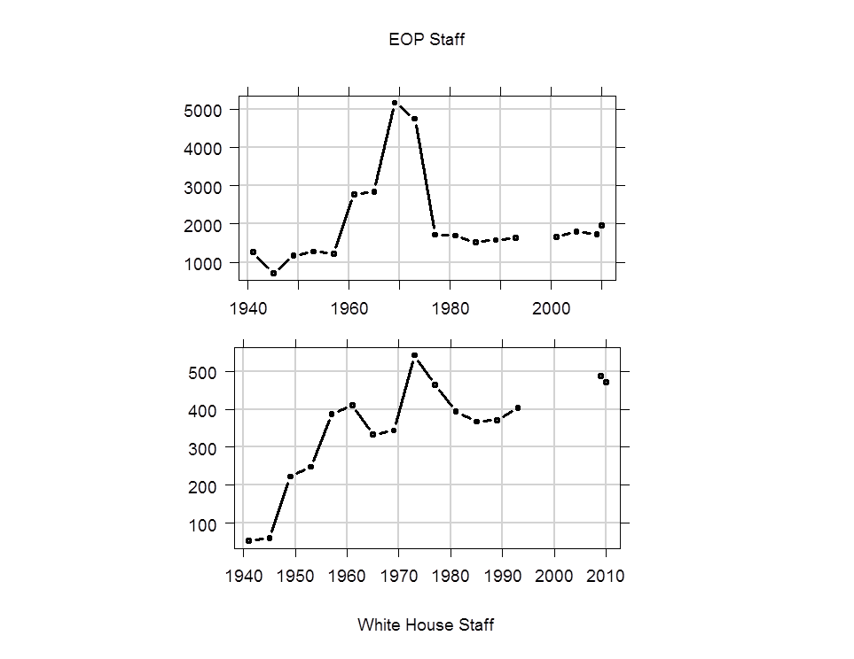
Growth of Presidential Resources

Slide 74
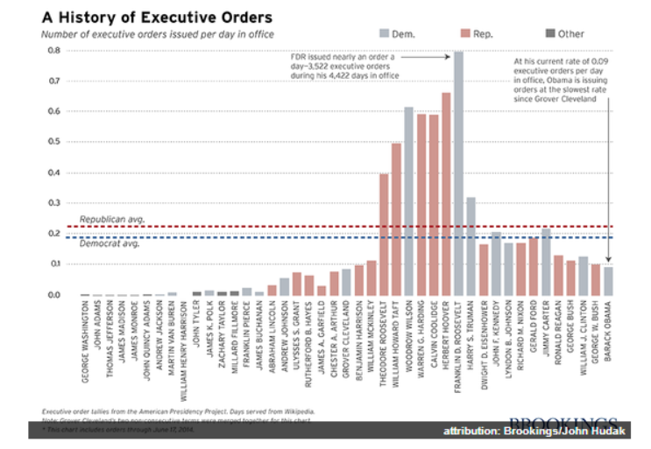
Executive Orders

Slide 75
Growth of WH and EOP creates the opportunity for presidents to intervene anywhere in the government as they wish
Over-riding the plans, programs, and desires of civil servants

Slide 76
Example: Immigration Policy

