Slide 1
Introduction to American Political Institutions
Session 1: Introduction & Constitution

Slide 2
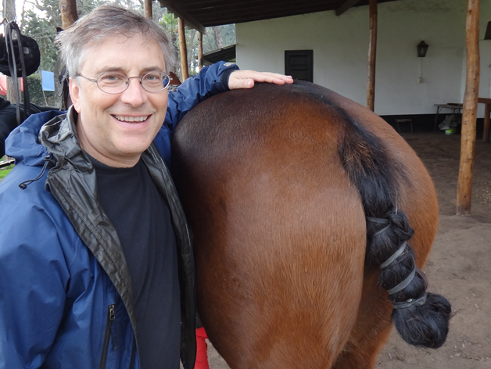
Charles Cameron
ccameron@princeton.edu

Slide 3
Course Schedule
Thursday 4.00-4.50 Session 1: Introduction, Constitutional Design, Incentive Systems
Thursday 5.00-5.50 Session 2: Congress
Thursday 6.00-6.50 Session 3: The President ( + Dinner)
Friday 9.00-9.50 Session 4: The Federal Civil Service
Friday 10.00-10.30 Session 5: U.S. Courts & Legal System
6. Friday 10.40-11.50 Session 6: The Elections Game: Understanding American Elections
7. Saturday 9.00-9.50 Session 7: Non-state Actors & Policy Influence Activities
8. Saturday 10.00-10.50 Session 8: The Main Contours of American Public Policy
9. Saturday 11.00-11.50 Session 9: The Future/Unanswered Questions

Slide 4
Why Care About American Politics?
Bad Reasons & (Maybe) Better

Slide 5
Bad Reasons
The U.S. is a role model to be imitated
The U.S. is a role model to be avoided

Slide 6
Better Reasons
Very hard to understand some SPI classes without some knowledge of American politics and society
  Esp SPI 501, 502, some others
“You may not be interested in war, but war is interested in you.”
  By virtue of historical accidents and lucky geography, the US is like the weather: ubiquitous
  The ability to forecast the weather can be useful
“Now I’m the Boss! Great! But wait a minute … What do I do?”
  Someday you may find yourself in charge of making good things happen or stopping bad things from happening
  Knowing how to pull the levers of power will be essential

Slide 7
Course Organization
Session 1: Introduction, Constitutional Design as Incentive Systems
Session 2: Congress (& Legislatures)
Session 3: President (& Chief Executives)
Session 4: Bureaucracy/Courts & Legal System
Session 5: Federalism/Electoral System
Session 6: The Elections Game (Duverger, Downs, and Wittman)
Lecture 7: Non-state Actors & Influence Activities (Interest Groups, Parties)
Lecture 8: The Shape of Public Policy (What USG Does)
Lecture 9: Current events & future enigmas

Slide 8
The American Constitution
What’s the basic idea?

Slide 9
Key Idea for Session1:
The “Rules of the Game” structure the incentives of the policy players
There is a lot more of course. But this is a starting place.

Slide 10
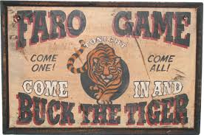
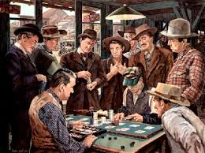
“I know it’s crooked but it’s the only game in town!”
--Canada Bill Jones

Slide 11
Outline
Parliamentary Design
  Nested Principals and Agents
  Accountability
  Incentives for Voters and Politicians
Separation of Powers Design
  Inter-branch Bargaining
  Accountability
  Incentives for Voters, Interest Groups and Politicians

Slide 12
Constitutional designs from a “Principal- Agent” perspective

Slide 13
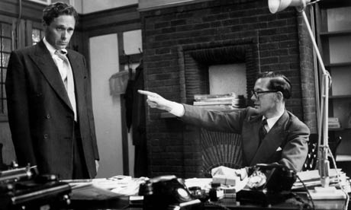
Principals = Boss
Agent = Worker

Slide 14
In policy making, who is the Boss and who is the Worker?

Slide 15
Two generic constitutional designs for democracies
Parliamentary Design
Separation-of-Powers Design (aka “presidential design”)

Slide 16
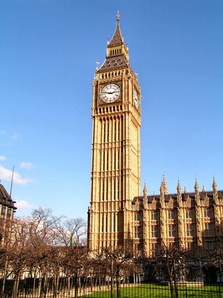
First Design: Parliamentary Systems
Voters
Elect
Parliamentary
Party
Choose
Cabinet/
Executive
Direct
Bureaucracy/
Courts

Slide 17
“Westminster System”
A two party system
Can have a parliament and multiparty systems

Slide 18
NESTED Hierarchy of Principals and Agents
PRINCIPAL
Voters ………………………..
Party …………………………..
Cabinet ……………………….
AGENT
Party
Cabinet (incl PM)
Bureaucracy

Slide 19
In each case the Agent has sufficient authority to get the job done
… And the Agent can be held ACCOUNTABLE by the principal

Slide 20
Formal Chain of Accountability
AGENT
Party ………is accountable to.
Cabinet …........is accountable to..
Bureaucracy …..is accountable to
PRINCIPAL
………….Voters
……..Party
….Cabinet

Slide 21
Elections
Not set by the calendar (broadly)
Instead: Brought on by a crisis that breaks the unity of the majority party
So, the election is about the crisis that broke the governing party
  Two parties offer distinct alternatives about how to handle the crisis
  Voters decide who has the best plan

Slide 22
Govt = A monopoly franchise held by a party
With periodic competition over the franchise created by a performance failure from the majority party

Slide 23
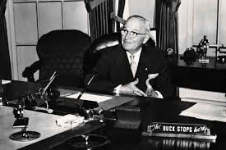
What is “Accountability”?

Slide 24


Slide 25
What are the conditions necessary for Principals to hold Agents Accountable?
The Principal can see what the Agent did (measure performance)
Hence, the Principal can allocate responsibility for failure/success to the Agent’s performance
The Principal has the ability to reward or punish the Agent based on Agent performance
  Esp., retain or fire

Slide 26
What are the Incentive Effects of the Parliamentary System for policy making?

Slide 27
First Design: Parliamentary Systems
Voters
Elect
Parliamentary
Party
Choose
Cabinet/
Executive
Direct
Bureaucracy/
Courts

Slide 28
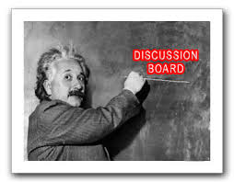
Incentives for Voters
Incentives for the Majority party
Incentives for Interest groups

Slide 29
What would the Founders of the American Republic have thought about this design?

Slide 30
“The accumulation of all powers, legislative, executive, and judiciary, in the same hands, whether of one, a few, or many, and whether hereditary, self-appointed, or elective, may justly be pronounced the very definition of tyranny.”
― James Madison, Federalist Papers

Slide 31
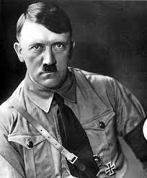
Bad Example for This Design
How did Hitler come to power?
He was lawfully elected!*
Then, there weren’t any more elections.
*Slightly complicated

Slide 32
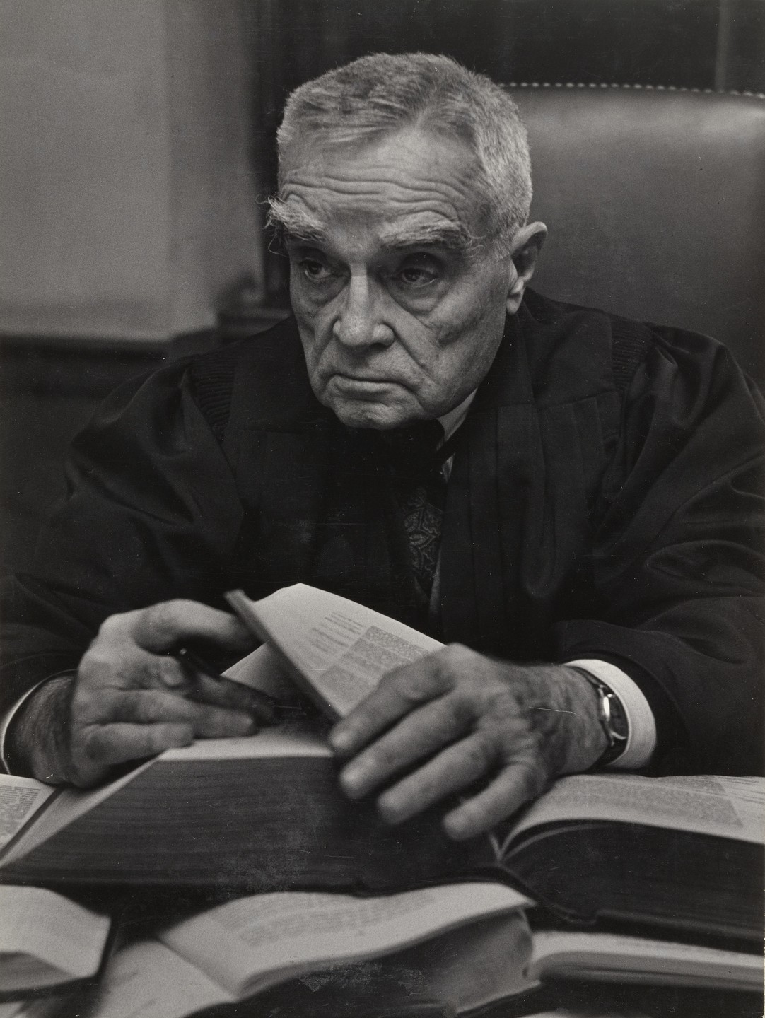
Learned Hand
“Liberty lies in the hearts of men and women; when it dies there, no constitution, no law, no court can even do much to help it. While it lies there it needs no constitution, no law, no court to save it.”

Slide 33
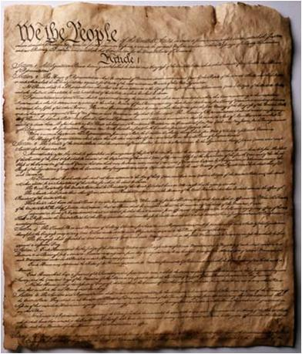
Second Design: Separation of Powers

Slide 34
Fact Alert!
The Constitution is very short and very terse.
  You can read the whole thing in a few minutes
  It is often ambiguous, to the delight of lawyers & law professors
It has 3 main parts (and some others)
  Article I: sets up Congress
  Article II: sets up the Executive branch
  Article III: sets up federal courts
  Some others retain states as primary/important units (esp Art 10)
It has amendments, some are very important
  #1: freedom of speech, press & religion
  #2: guns (?)
  #4: search and seizure, warrants
  #5: no punishment without due process of law, no self-incrimination
  #13: abolishes slavery (after a huge civil war)
  #14: establishes idea of national citizenship rights (vs state citizenship rights) + equal protection

Slide 35

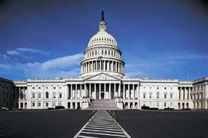
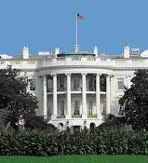
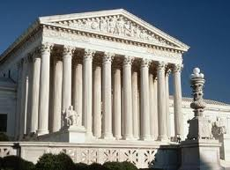


Slide 36
???
3 Branches
Different “selectorates”
Staggered Elections
No cabinet government

Slide 37
The Logic
Democracy
Big
Tyranny
Big
Small
SMALL

Slide 38
Checks and Balances Are Intended to block a transition to tyranny
Bicameral legislature
Different geographic constituencies for each chamber
Staggered elections
Independently elected president, not selected by Congress
No cabinet government
Presidential veto of legislation
Independent judiciary

Slide 39
Staggered Elections – Why?
House members every 2 years
Senate members every 6 years
  1/3 up for election every 2 years
President every 4 years
No party can get control of everything in one election
  Takes winning twice in a row at least, and maybe 3 times!
  Protection against demagogues and momentary bad judgment of voters…. But also …

Slide 40
Members of Congress are constitutionally prohibited from serving in the executive
So a cabinet government of a parliamentary system is literally impossible, under the US Constitution
Again, preventing power in one set of hands

Slide 41
Result of Fragmenting Power over 3 Branches:
Policy making via institutional bargaining
“Separated institutions sharing power”

Slide 43
Result: Unclear Accountability
Who is charge? Everyone and no one
Who can be held accountable? No one?

Slide 44
Result: Divided Party Government Can and Does Occur

Slide 45
Notes:
Sometimes split chamber congresses in the late 19th century and recently, but usually president of one party vs Congress of another

Slide 46
Fundamental:
Huge Status Quo Bias
Absent near-universal agreement, very little can happen
Though not nothing

Slide 47
Incentive Effects

Slide 48
Voters …
  Since no one is in charge:
  Rational ignorance

Slide 49

The American Voter

Slide 50

The Median Voter
52 year old white woman
No college degree
Independent, not a Republican or Democrat
Drives an SUV
Lives in the suburbs
Of a “boring” city
Voted twice for Obama
Husband voted for Trump
Has little interest in politics and doesn’t like talking or thinking about it

Slide 51
Voters …
Since government is unresponsive:
  Low expectations

Slide 52
Voters …
Since there is no collective responsibility:
  Try to select a “good” guy as your representative

Slide 53
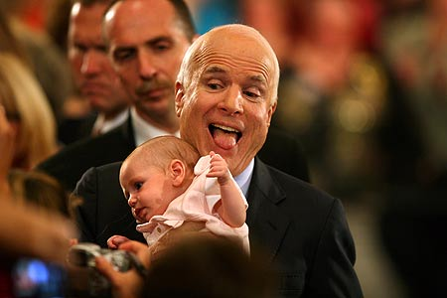
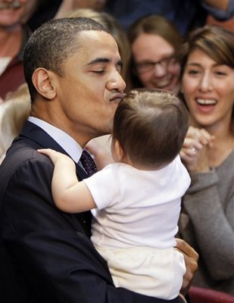
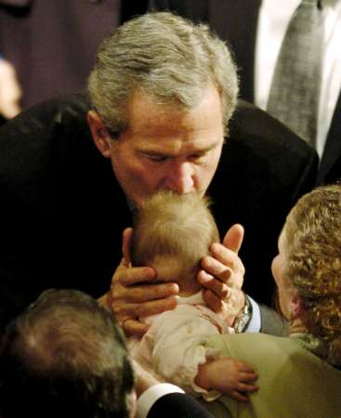
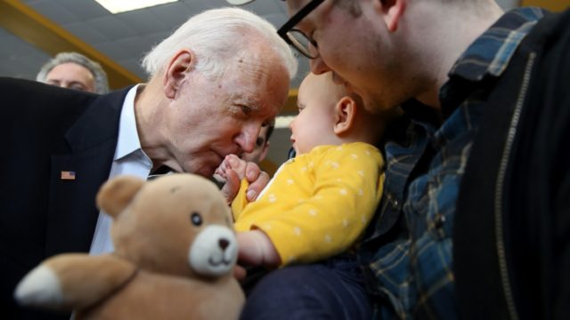

Slide 54
Politicians …
Since voters are ignorant and apathetic:
Serve the organized

Slide 55
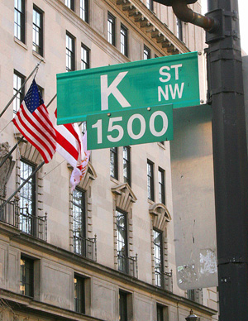

Slide 56
Politicians …
Since you aren’t accountable for results:
Take (meaningless) positions

Slide 57
Politicians …
Since voters want good guys:
Deliver pork to the district and personal services to voters

Slide 58
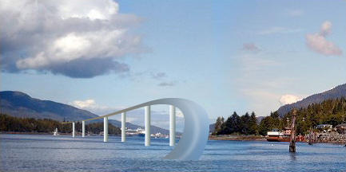

Slide 59
Interest Groups and Firms
If government is small & can’t do anything:
Ignore it and sell things

Slide 60
But suppose government is large …then what?

Slide 61
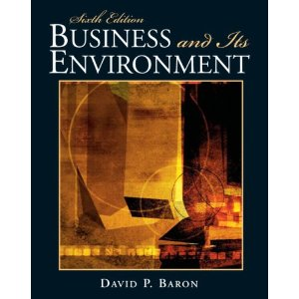

Slide 62
“Non-market Strategy”
How to make money by manipulating government

Slide 63
Side Note
Teaching businessmen how to manipulate government in order to make money, is pretty easy
Teaching YOU how to manipulate government in order to save the world, is HARD

Slide 64
Interest Groups and Firms …
Because voters are ignorant:
Use government to Make Money/Push Interests

Slide 65
A Target Rich Environment

Slide 66
Interest groups & firms …
Because there are so many access points:
Push Congress, push President, push agencies, push courts
Push state governments

Slide 67
Interest groups and firms …
Because of Status Quo Bias –
Mostly you won’t get anything … but when you do you can probably keep it

Slide 68
Coming Up:
Congress

